Slide 1

Enterprise Network Infrastructure
Project
Designed & Implemented by:
Name | ID
Mina Estfanous | 21026681
Ahmed Mahmoud | 21020112
Abdallah Essam | 21040042
Mohamed Bakr | 21043984
Omar Osama Elnahass | 21040042
Instructor:
Eng. Ahmed El-Emam

Slide 2
Project Overview
Our project focuses on designing a complete enterprise network.
Ensures secure communication between departments.
Supports routing, switching, servers, and firewall security.
Built using Huawei devices on eNSP

Slide 3
Project Goals
Create a stable and scalable network.
Enable communication between all VLANs.
Secure the network using ACL + firewall rules.
Provide Internet access through ISP.
Automate IP assignment via DHCP.
Build a future-ready enterprise infrastructure

Slide 4
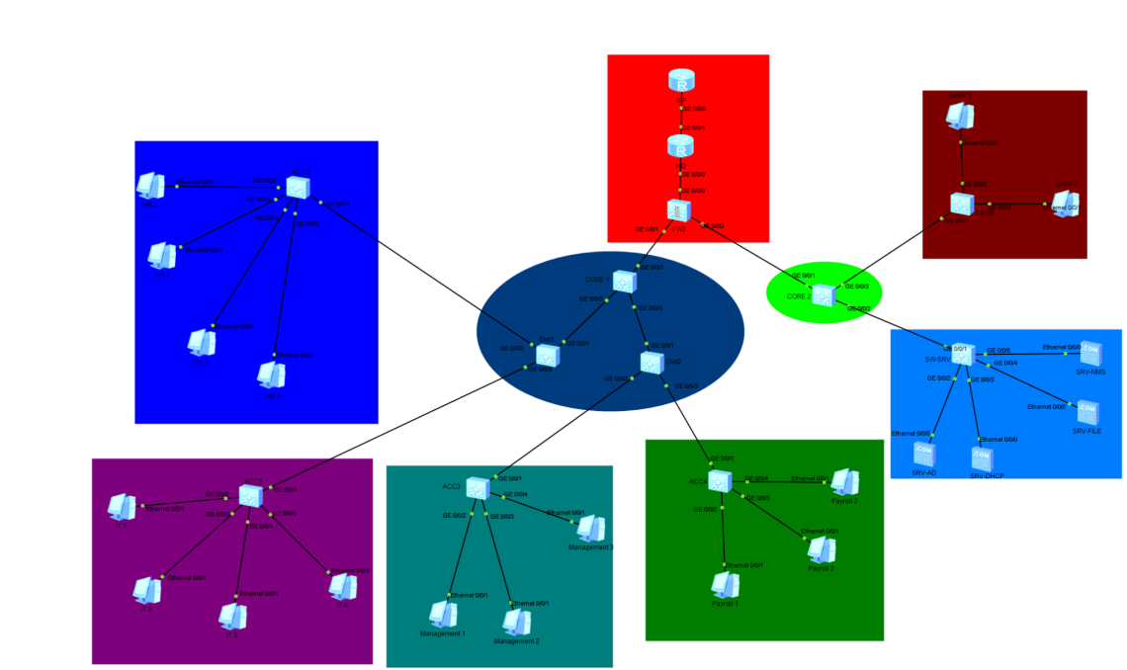
Network Topology
3-Layer Hierarchy
Core Layer: CORE1, CORE2
Distribution Layer: Dist1, Dist2
Access Layer: ACC1, ACC2, ACC3, ACC4
Firewall + ISP Router
Server Farm + Client PCs

Slide 5
VLAN Design
VLAN | Subnet Department
HR 10 | 192.168.10.0/24
IT 20 | 192.168.20.0/24
Management 30 | 192.168.30.0/24
Payroll 40 | 192.168.40.0/24
Servers 50 | 192.168.50.0/24
Backbone 99 | 192.168.99.0/24

Slide 6
IP Addressing
VLAN interfaces on CORE1 & CORE2 act as gateways
Server VLAN uses static IP addresses
User VLANs rely on DHCP
Point-to-Point links use /30 networks

Slide 7
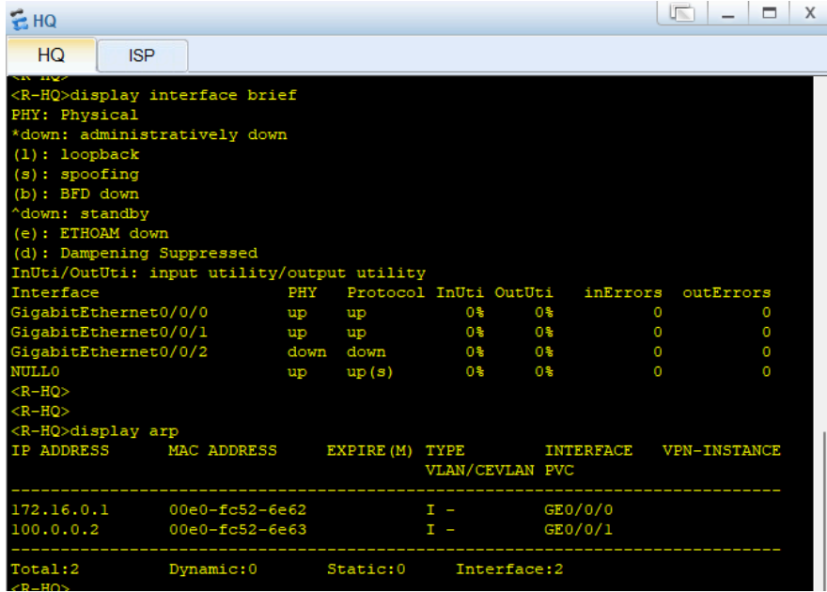
Routing (OSPF)
OSPF Area 0 used across the network Configured between:
ISP ↔ Firewall
Firewall ↔ CORE1
CORE1 ↔ Dist1, Dist2
CORE2 ↔ Firewall
Benefits: Fast convergence ,Dynamic updates ,Loop prevention

Slide 8
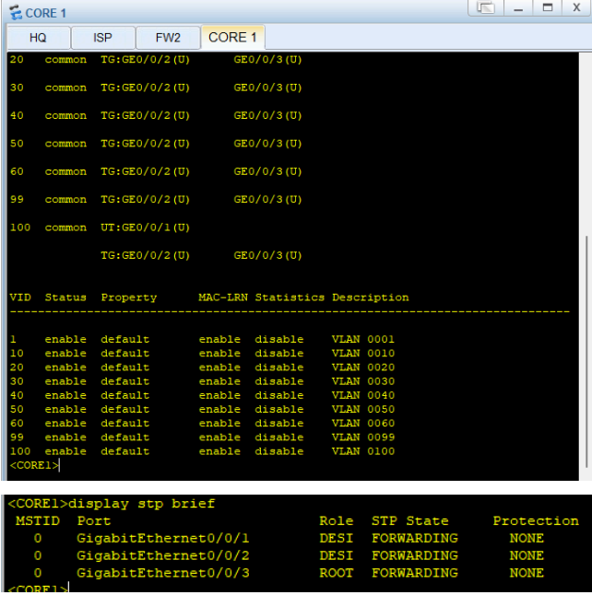
Switching Configuration
Trunk links between Core ↔ Distribution ↔ Access
Access ports assigned to correct VLANs
Spanning Tree enabled by default
Supports scalability and stability

Slide 9
DHCP Configuration
DHCP server configured on CORE1
Pools created for: HR, IT, Management, Payroll, Servers
DHCP Relay enabled on Dist1 & Dist2 to forward DHCP requests
Ensures automatic IP assignment to all PCs

Slide 10
Security (ACL Rules)
ACL used to:
Limit access between VLANs
Allow IT department admin access
Protect Management VLAN
Secure backbone VLAN
Applied on CORE1, CORE2, and Firewall

Slide 11
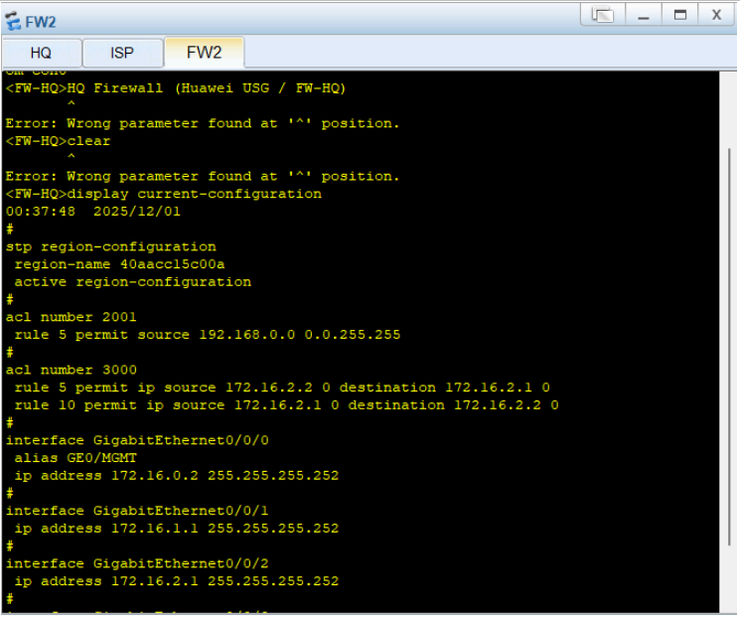
Firewall Security
Policies created on FW-HQ:
Allow internal LAN → Internet
Allow OSPF updates
Control traffic to/from servers
Deny unauthorized access
NAT configured for Internet access

Slide 12
Server Infrastructure
VLAN 50 includes:
Active Directory Server
DHCP Server (optional backup)
File Server
Monitoring (NMS)
Backup Server
All servers use static IPs.

Slide 13
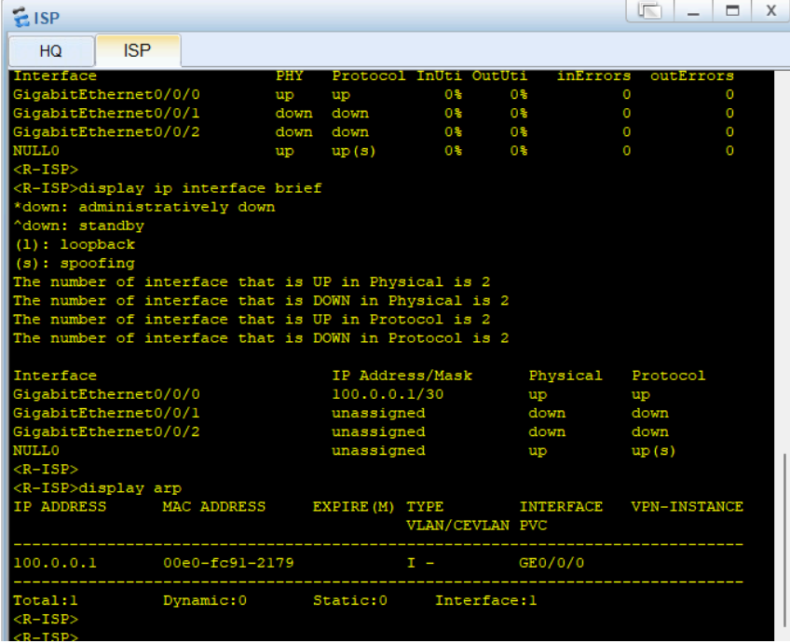
Testing & Troubleshooting
Tested | Fixed Issues
Ping between all VLANs | Wrong VLAN tagging
Routing table propagation | ACL blocking traffic
OSPF neighbor states | FW blocking ICMP
DHCP address assignment | DHCP relay not enabled properly
Firewall permit/deny rules
Internet access (8.8.8.8)

Slide 14
Results
Fully functional enterprise network
Secure communication between departments
Internet connectivity for all VLANs
Centralized DHCP working
Routing stable via OSPF
Firewall policies applied correctly

Slide 15
Conclusion
Project achieved all goals
Network is secure, scalable, and future-ready
Supports servers, users, and management
Demonstrates complete enterprise data-center design

